Slide 1

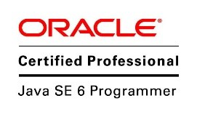
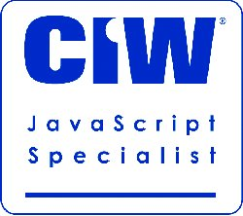
Introduction to Node.js and ExpressJS
Mark J. Buckler
OCPJP,CIWJS

Slide 2

Credits
Some of the contents of this slide presentation have been referenced and reproduced, from Learning Node.js (2015), by Alexander Zanfir, ©2017 LinkedIn Corporation.
Additional content has been referenced and reproduced, from Node.js Essential Training, by Alex Banks, ©2017 LinkedIn Corporation.

Slide 3
LEARNING OBJECTIVES
Introducing Node.js
Installing Node.js
Synchronous vs. Asynchronous Tasks
Node.js and JavaScript
Node.js Modules
The package.json file
File and Directory I/O
Frameworks and Web APIs
ExpressJS
Promises

Slide 4
Introducing Node.js
Node.js
It is open-source
It is cross-platform
It is a runtime environment
Applications for Node.js
Written in JavaScript
Front-end and back-end can be written in the same language

Slide 5
Introducing Node.js
Node.js Characteristics
It is built on top of the Chrome V8 JavaScript engine
It is fast
It is event-driven
It has a non-blocking I/O model
Node.js Ecosystem
Node.js has a package manager, NPM
It provides access to the largest source of open-source libraries in the world

Slide 6

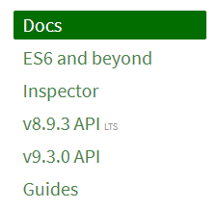
Introducing Node.js
Documentation https://nodejs.org/en/

Slide 7
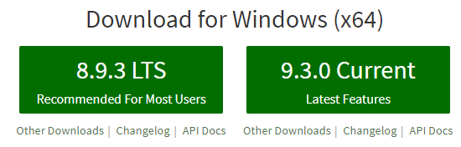
Installing Node.js
Node.js.org has various installation options
Windows is the default install
It may be installed by a click on the button for the desired version
For macOS or Linux, go to Other Downloads

Slide 8
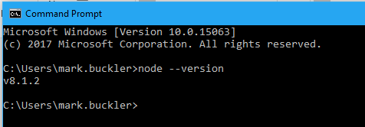
Installing Node.js
Installation Testing
Open a terminal
Enter the command:
node –v or node --version
Successful installation should produce the following result

Slide 9

Asynchronous Tasks
Synchronous vs. Asynchronous Tasks
A synchronous task must finish before moving on to another task
Therefore it is said to be blocking in nature
It blocks the other task from proceeding

Slide 10
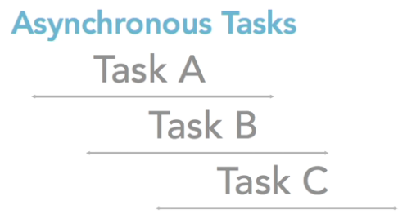
Asynchronous Tasks
Synchronous vs. Asynchronous Tasks
An asynchronous task can move on to another task immediately
This type of execution is known as non-blocking
Does not have to wait for the first task to finish

Slide 11

Asynchronous Tasks
Example: Form Submission
Can cause long completion time tasks over a client-server network
Background processes run synchronously
Blocks responsiveness on the client user interface
The client is waiting on the server response to complete
Some of the longest processing completion times are networking and file system access

Slide 12
Asynchronous Tasks
Node.js Synchronous Example
var fs = require('fs');
var data = fs.readdirSync(’c:/’);
console.log(‘data: ', data);
console.log('This code is last');
Synchronous method

Slide 13
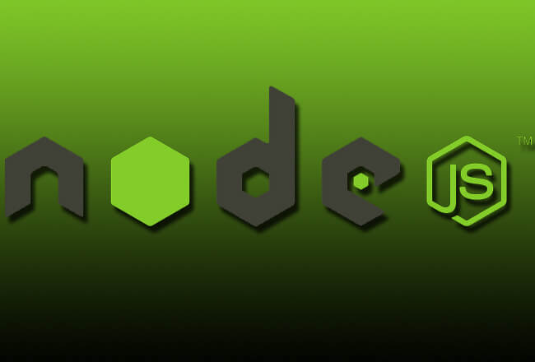
Asynchronous Tasks
Programming Exercise01_01_01 – Step 1
Coding a Synchronous Task

Slide 14
Asynchronous Tasks
Node.js Asynchronous Operations
Web applications perform network and file system access very frequently
Node’s capabilities of asynchronous I/O enable excellent performance
Node accomplishes asynchronous operations through the use of callbacks

Slide 15
Asynchronous Tasks
Node.js Asynchronous Operations
Node.js uses a simple event-driven architecture
Applications for Node are capable of asynchronous I/O
Many connections can be handled concurrently
Enables fast performance without using multi-threading
It makes use of an event loop
It is therefore non-blocking in its execution

Slide 16
Asynchronous Tasks
Node.js Asynchronous Example
var fs = require('fs');
function phoneNumber(err, data) {
console.log('data:', data);
}
fs.readdir('c:/', phoneNumber);
console.log('This code is last');
callback
Use of
callback
Asynchronous method

Slide 17
Asynchronous Tasks
Programming Exercise01_01_01 – Step 2
Coding an Asynchronous Task

Slide 18
Asynchronous Tasks
Callbacks
It is a standard practice among node.js programmers to write callbacks as anonymous functions
var fs = require('fs');
fs.readdir('c:/', function(err, data) {
console.log('data:', data);
});
console.log('This comes after');
Anonymous function as callback

Slide 19
Asynchronous Tasks
Programming Exercise01_01_01 – Step 3
Callback as an Anonymous Function

Slide 20
Node.js and JavaScript?
Background
Web apps have front-end components
All browsers understand JavaScript
Modern web technologies, like Node.js, are trending toward using JavaScript on the back-end as well

Slide 21
Node.js and JavaScript?
Benefits of Using the Same Language
No syntax differences between the languages
Shared code and data structures
Encryption, authentication, and authorization, such as OAuth
Data models: structures holding data, often transferred back and forth, client and server: often JSON
Maintenance levels are much less overhead

Slide 22
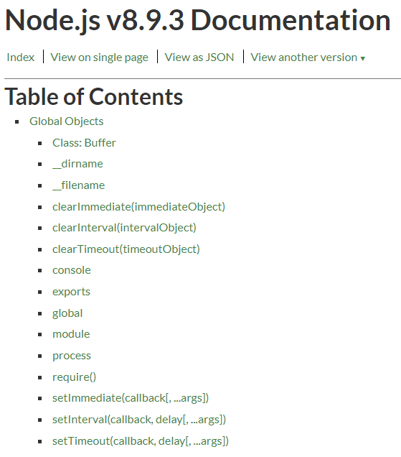
Node.js and JavaScript?
Node.js API
Node.js has a very robust API for JavaScript
Available on the Node.js website
Global Objects
API objects available in code without need of a require() statement
The global namespace is assumed

Slide 23
Node.js and JavaScript?
Global Objects
console
Has method console.log()
Similar to the JavaScript console mechanism provided by web browsers
Prints to the stdout and stderr streams of the terminal, not the browser console
Can take concatenated strings or comma separated parameters
__dirname
It is a global variable, used to hold the full path to the current directory

Slide 24
Node.js and JavaScript?
Global Objects – require()
It is a global method, used to require modules for use in another module

Slide 25
Node.js Modules
Modules
Modules support the re-use of code
In node.js the concept of a code file and a code module are synonymous
The require()global method is used to bring a module into a code file
The exports global object tells a module what to make available to other modules
This is done by setting properties on the exports object that contain that which is to be made available

Slide 26
Node.js Modules
Core Modules
Modules that are shipped with node.js
They are not global, so they cannot just be used
The require()global method is used to bring a core module into a code file
Useful core modules, see the API documentation
path: has much functionality to deal with file and directory paths
console: has many more functions besides log()
errors: useful functions for error processing
http: many low level utilities for request and response handling

Slide 27
Node.js Modules
Programming Exercise01_01_01 – Step 4
Writing and Using a Node.js Module

Slide 28
Node.js Modules
Third-Party Modules
Modules that are made available from third parties are called packages
Packages bundle together one or more modules
Node.js comes with a utility, NPM, or Node Package Manager
To install a package locally, command line syntax is npm install packageName
To install a package globally, command line syntax is npm install packageName -g
A folder named node_modules is placed in the project, which can be very large

Slide 29
Node.js Modules
Gulp Module https://gulpjs.com/
Gulp is a toolkit for automating painful or time-consuming tasks in your development workflow
gulp.task()is a method of the package used to Define a task using Orchestrator
Its syntax is defined in the API docs on the website

Slide 30
Node.js Modules
Programming Exercise01_01_01 – Step 5
Managing Third-Party Packages with NPM

Slide 31
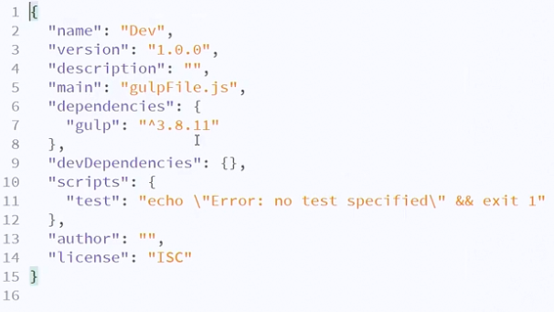
package.json
The package.json File
A file that is used to store information about project, including a list of its dependencies

Slide 32
package.json
The package.json File
Distributing a project with all of the node_modules materials can be very bulky
It would also take up a lot of space in a Git repository
Distributing without the node_modules would cause the client to have to manually install them
The package.json file, combined with the npm install command solves this problem
The file is built by using the npm init command in the project folder
After the package is distributed, running npm install will build the node_modules

Slide 33
Node.js Modules
Programming Exercise01_01_01 – Step 6
Building a package.json File

Slide 34
File and Directory I/O
Reading Files
Node.js is predominantly server-side programming, so it is heavy on disc access
The API provides a file system library named fs
It is not global, so a require()is necessary to access its features
It is a core module, so NPM is not required to install it
There is a large amount of resources listed in the node.js API documentation

Slide 35
File and Directory I/O
Reading Files
fs.readFile(path[,options], callback)
Reads the entire contents of a file asynchronously
The callback returns an error or data
The optional second parameter can contain the encoding of the file
The require() method can also read the contents of a file, but it has different characteristics
It can actually read and translate objects from the file

Slide 36
File and Directory I/O
Programming Exercise01_01_01 – Step 7
Reading Files

Slide 37
File and Directory I/O
Reading Directories
fs.readdir(path[,options], callback)
Reads the entire contents of a directory asynchronously
The call excludes ’.’ and ’..’
The callback returns an error or data
The optional second parameter can contain the encoding of the filenames

Slide 38
File and Directory I/O
Programming Exercise01_01_01 – Step 8
Reading Directories

Slide 39
File and Directory I/O
Writing Files
fs.writeFile(path, data[,options], callback)
Writes the data to a file synchronously
Replaces the file if it already exists
The data can be a string or a buffer
The options parameter can contain
The encoding of the data
The mode of the file in octal, such as 0666
The flag of the file as a char, such as ’r’, ’w’, ’a’
The callback returns an error or data

Slide 40
File and Directory I/O
Programming Exercise01_01_01 – Step 9
Writing Files

Slide 41
Frameworks and Web APIs
Software Frameworks
A framework is an essential supporting structure of an object
A software framework is an essential supporting structure that allows you to build on top of it
We can leverage Web frameworks to allow us to build large APIs or HTTP servers
Can provide us with components to make serving static files like traditional websites easy
We can also put together Web APIs

Slide 42
Frameworks and Web APIs
Web APIs
A service that supports getting or saving data to a server or back-end
Examples
User registration
Data retrieval
Authentication and authorization
Database storage

Slide 43
ExpressJS
Introduction to ExpressJS https://expressjs.com/
A Web framework for Node.js
Supports Web Applications and APIs
Web Applications
Usually have both front-end and back-end functionality
Are distributed across the front and back ends
Characteristics
Runs within Node.js, which is just on the back-end
Has been around a long time, so well supported and documented
Uses very traditional development features

Slide 44

ExpressJS
Using ExpressJS Inside Node.js
Should be installed with NPM globally and locally
Express must first be accessed from the node_modules with a require()statement
An express object must be instantiated to make use of the Express methods and properties
We can turn our node.js application into a server by using the listen()method of Express and passing it a port number

Slide 45
ExpressJS
Static vs. Dynamic Content
Static content could be files containing HTML, CSS, images, client-side JavaScript, etc.
Dynamic content is usually served through a Web API or used to render a dynamically changing page on the server
To serve static files with Express, we employ its use()method
We must tell node that it is static by using the Express static(path)method
We can use the global variable __dirname to indicate the current directory
Index.html would be the default file used

Slide 46
ExpressJS
Programming Exercise01_01_01 – Step 10
Serving Static Files with ExpressJS

Slide 47
ExpressJS
Dynamic Content using Endpoints
An endpoint must be created to serve dynamic content
Allows access to a specific resource on a server or a specific action of a resource
An action could be writing, reading, etc.
The endpoint is also set up with the app.use() method, with some differences
The first parameter is the URL of the resource
The second parameter is a callback
This kind of callback has a request and a response, and is called middleware

Slide 48


ExpressJS
Dynamic Content using Endpoints
Middleware
Middleware is something that actually executes between an HTTP request and response
It would be set up with Express as follows:
To set up a response that would be passed forward, we use the second parameter of the middleware callback

Slide 49
ExpressJS
Programming Exercise01_01_01 – Step 11
Creating Endpoints with ExpressJS

Slide 50
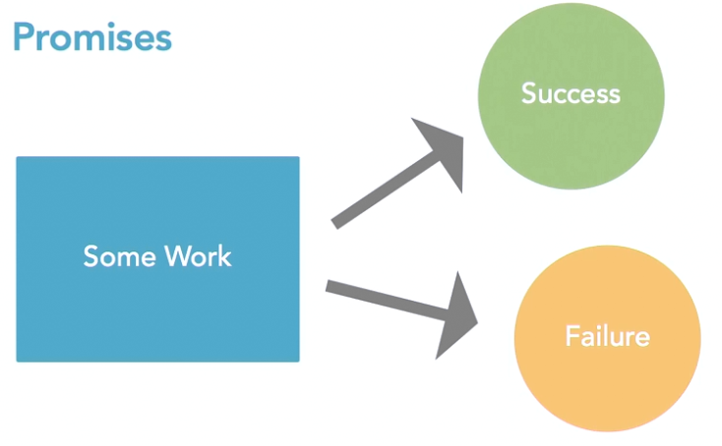
Promises
What are Promises?
Promises are another option for use in working with asynchronous code
Promises return an object which “promises” to do some work
The object has separate callbacks for success and failure

Slide 51
Promises
Advantages of Promises
Let us work with asynchronous code in a more synchronous way
Problems with asynchronous code
Can lead to a large set of nested callbacks
This can get so complicated that it actually professionally referred to as callback hell
The code

Slide 52
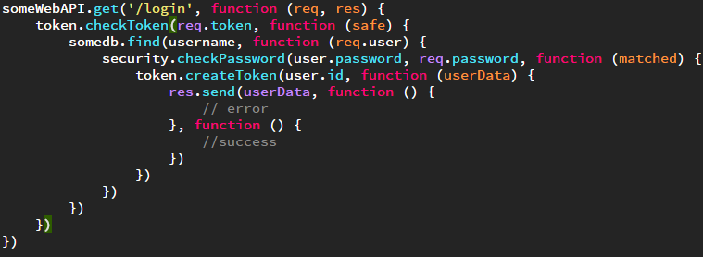
Promises
Callback Hell
The callbacks get chained deeper and deeper in the code
Makes the code very unpleasant and confusing to look at

Slide 53
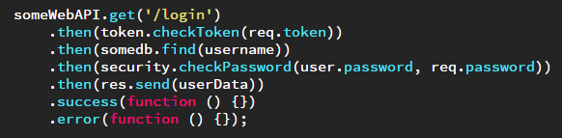
Promises
Using Promises to Solve the Problem
Promises are built with dependency chains
The tasks are chained into synchronous tasks using the then()function
This is just a look at promises, we will study them in depth in our next unit on JavaScript ES6.

